Slide 1


INNOVATORS
-> MANVI MITTAL
-> PRIKSHIT
-> RAGHAV MITTAL
-> NIKHIL

Slide 2


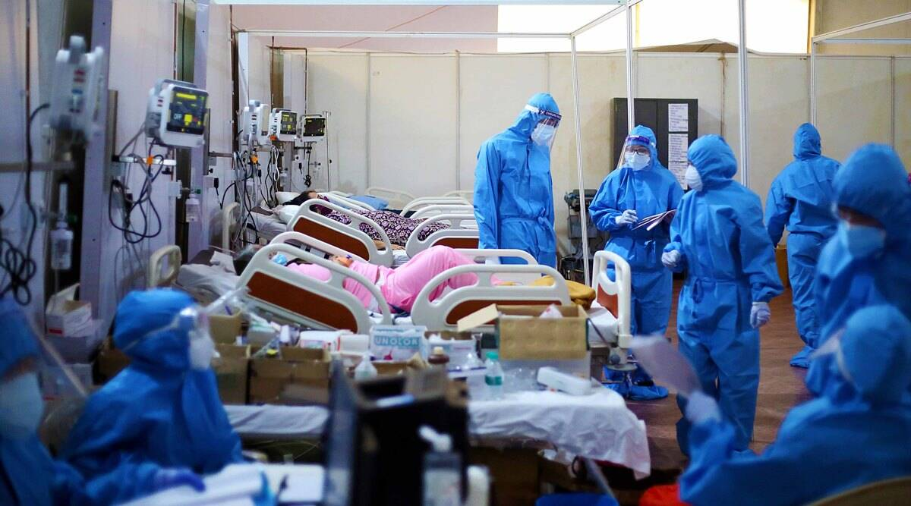

PROBLEM STATEMENT
In Corona we are face so many difficulty for related to medical issues. So just we how to solve the medical issues those face in corona.
We face doctors has no appointment time and can’t cover all the patients.

Slide 3
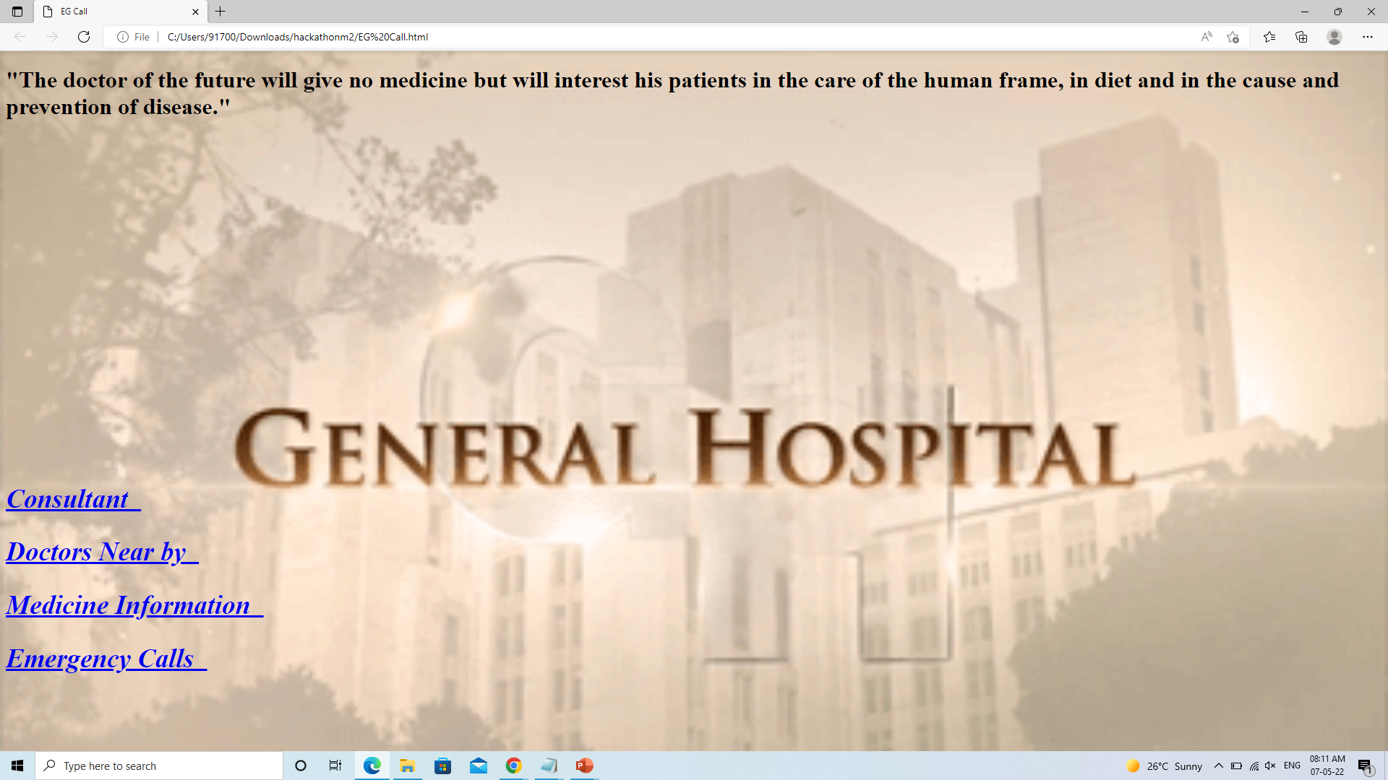
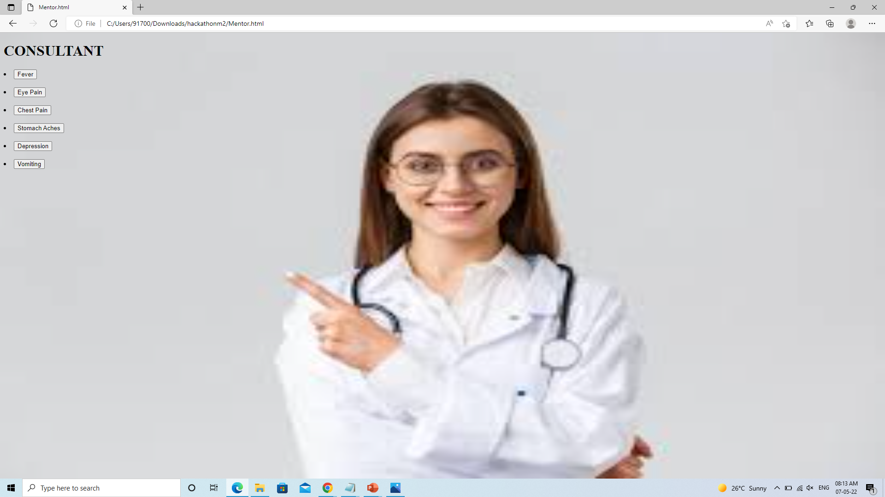
PROPOSED SOLUTION
We are building a website to solve the medical problems and knowledge new skills for my side.. And share my knowdege with you.. And we share my problem those who face in corona…

Slide 4



:-TECH SOLUTION:-
:- We are Using such a little bit Tech knowledge like Javascript, CSS, HTML and so far…

Slide 5
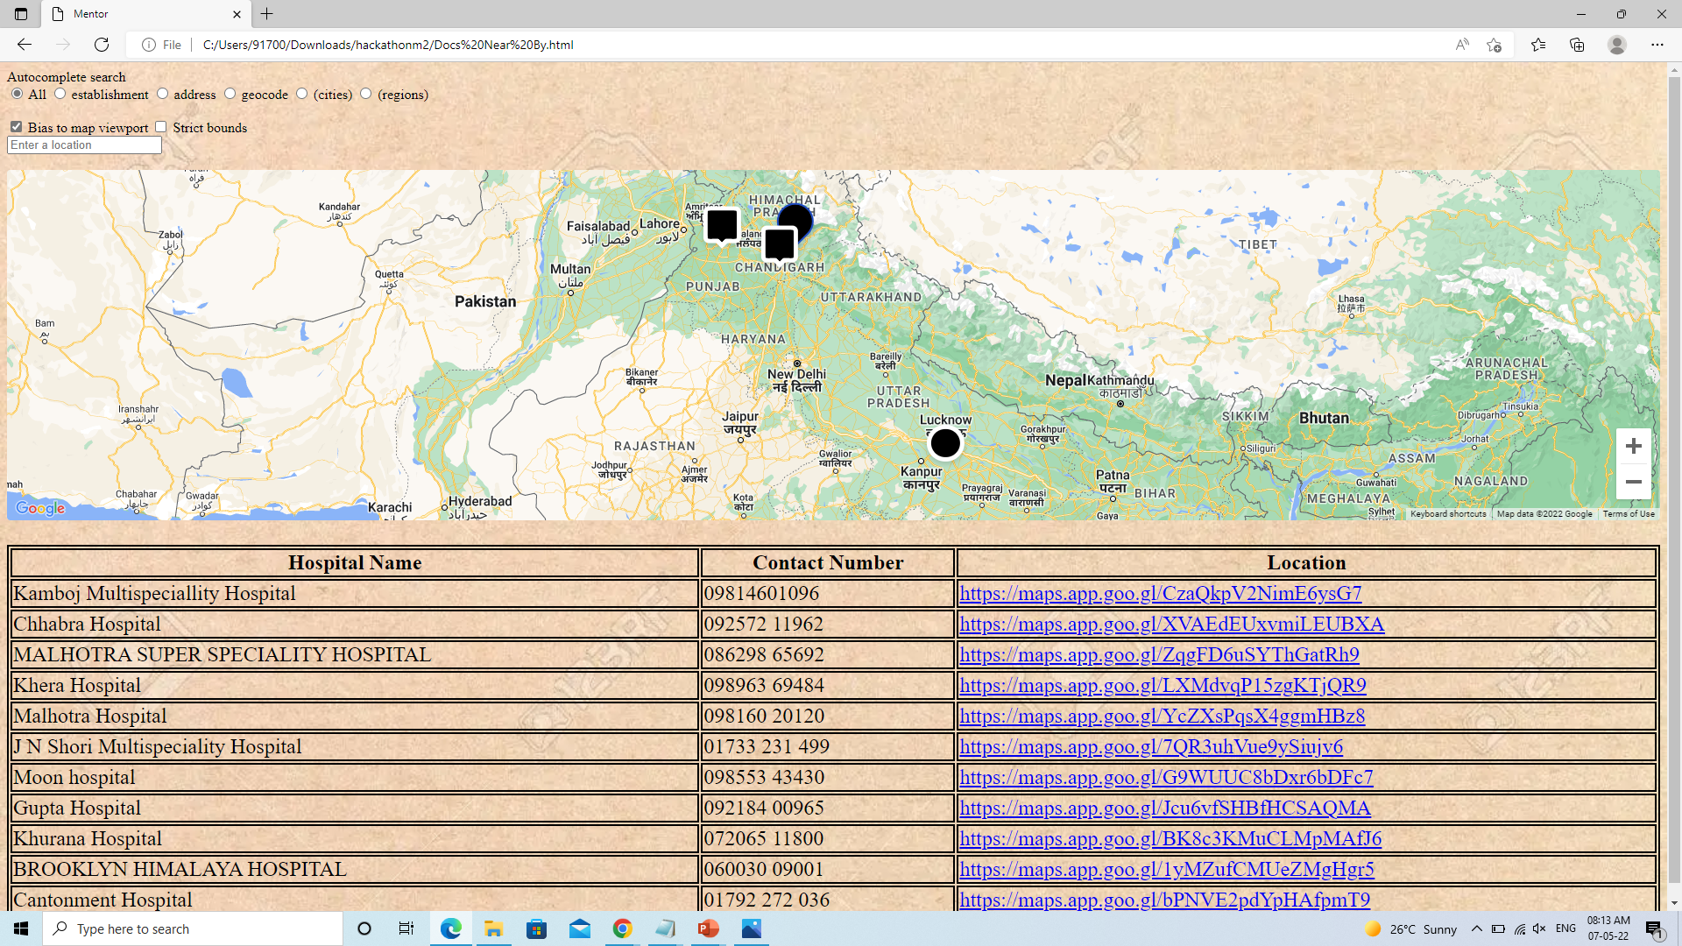
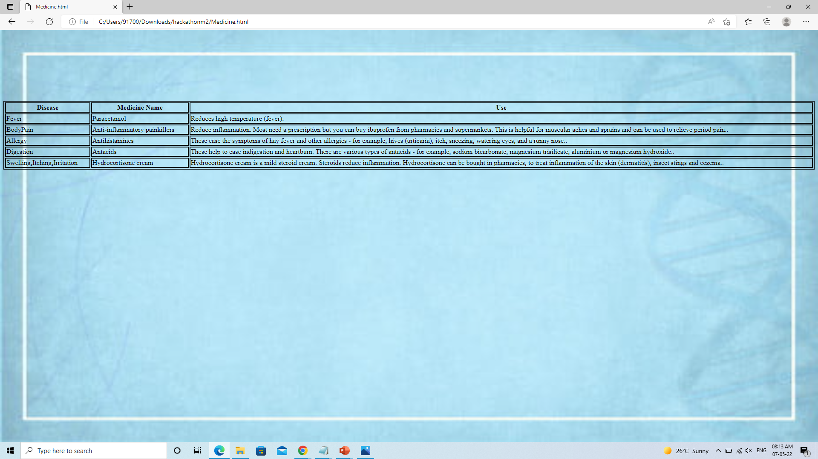
APPROACH
1. We tried to build a website for patients as well as doctors. Which could help them both to save there time….
As we know in past few years due to covid many people couldn’t get to the hospital for there proper treatment for this website can hep such people who can’t visit hospital….
More over many NGO’s are also ready to tie up with such innovative ideas which can help the people and benift them…

Slide 6

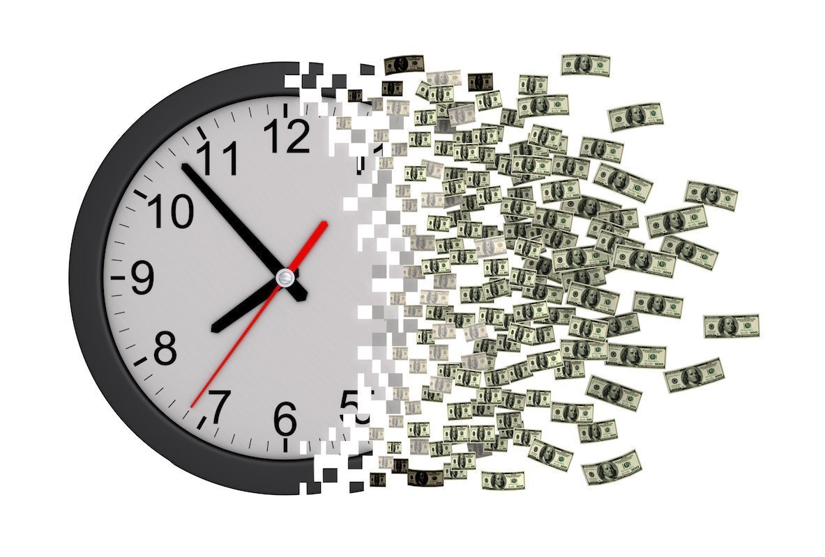
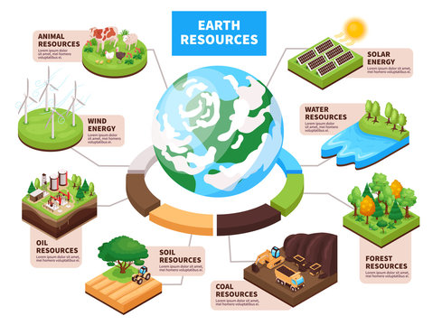

Uniqueness
Fast way of service
Money saving
Natural resource saving
Time saving

Slide 7

Uniqueness
THANKU SO MUCH TO SEE YOUR PROJECT :-

